Slide 1


HAROHAR

Slide 2
Technology Used
Qtcreator
C++
Cmake
Cloud compare –github src-code
PostGreSql -9.3
Python 2.7(PyQt4,gdal,PIL,psycopg2)
Qt Designer(Qt 5.6)

Slide 3
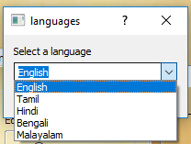
Language Selection At the Beginning Of Dharohar

Slide 4
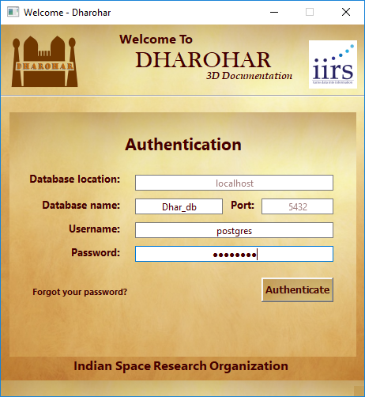
Authentication Page For Login

Slide 5
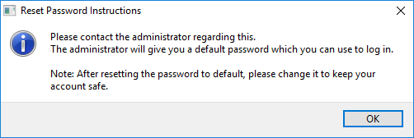
Forgot Password

Slide 6
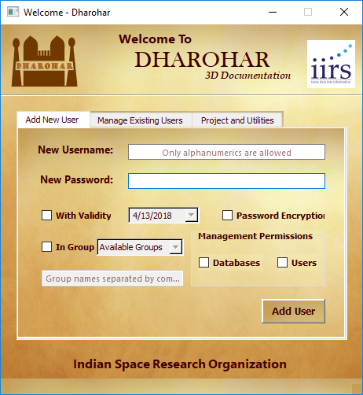
Admin can Add New Users

Slide 7
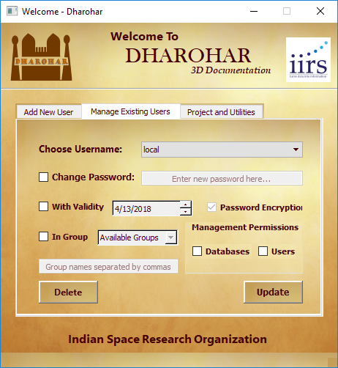
Admin can Manage Existing Users

Slide 8
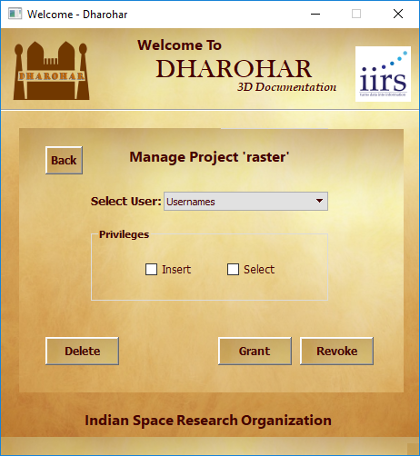
Existing Projects Can be Managed

Slide 9

New Project can be created

Slide 10
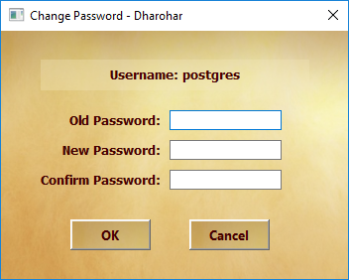
Change Password

Slide 11

Credits

Slide 12
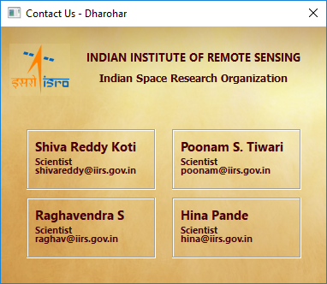
Contact Us

Slide 13
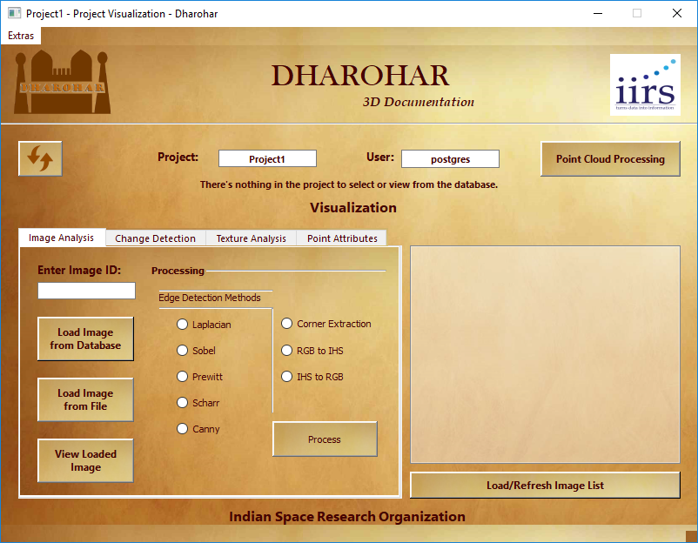
Proceeds to Visualization window

Slide 14
POINT CLOUD PROCESSING

Slide 15
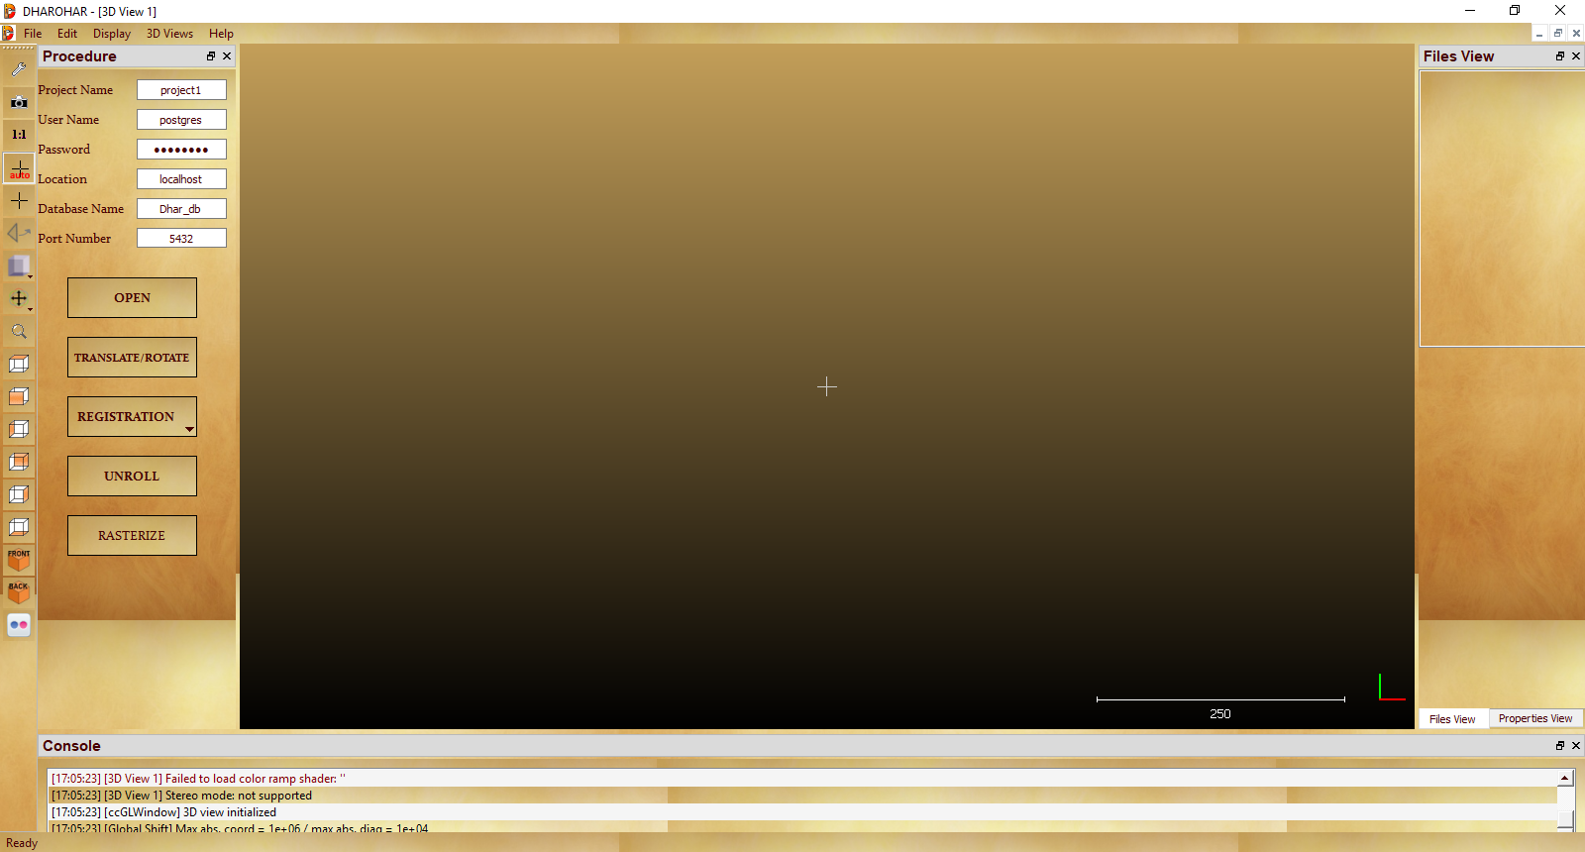
Dharohar

Slide 16
Menu Screenshots

Slide 17
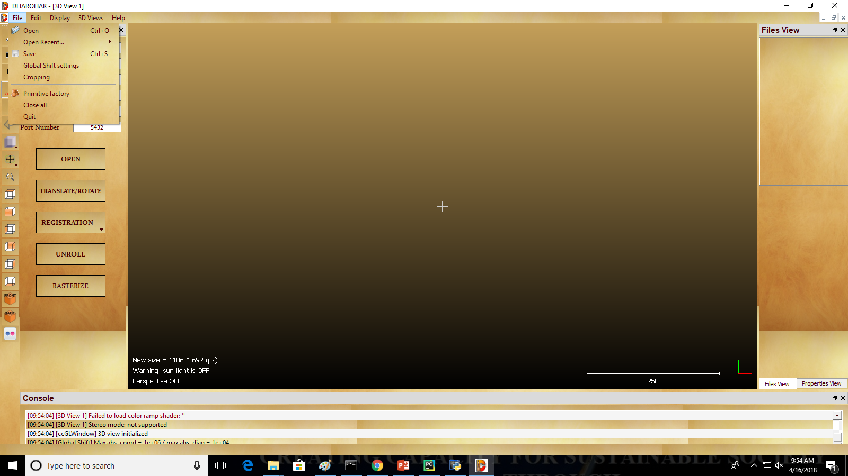
File Menu

Slide 18
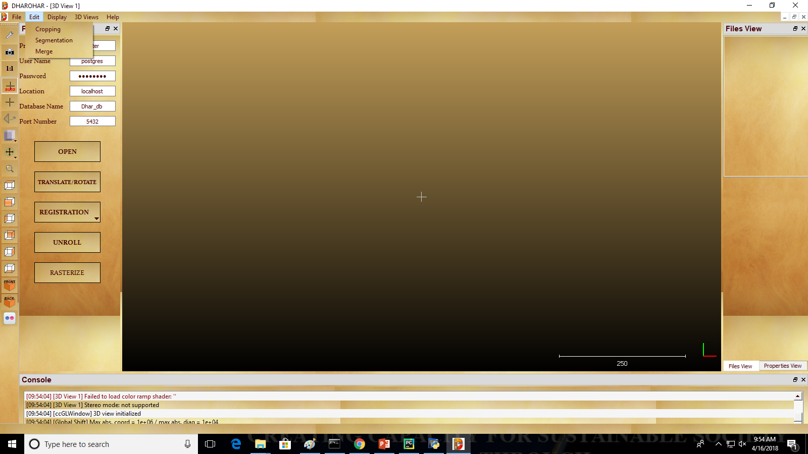
Edit Menu

Slide 19
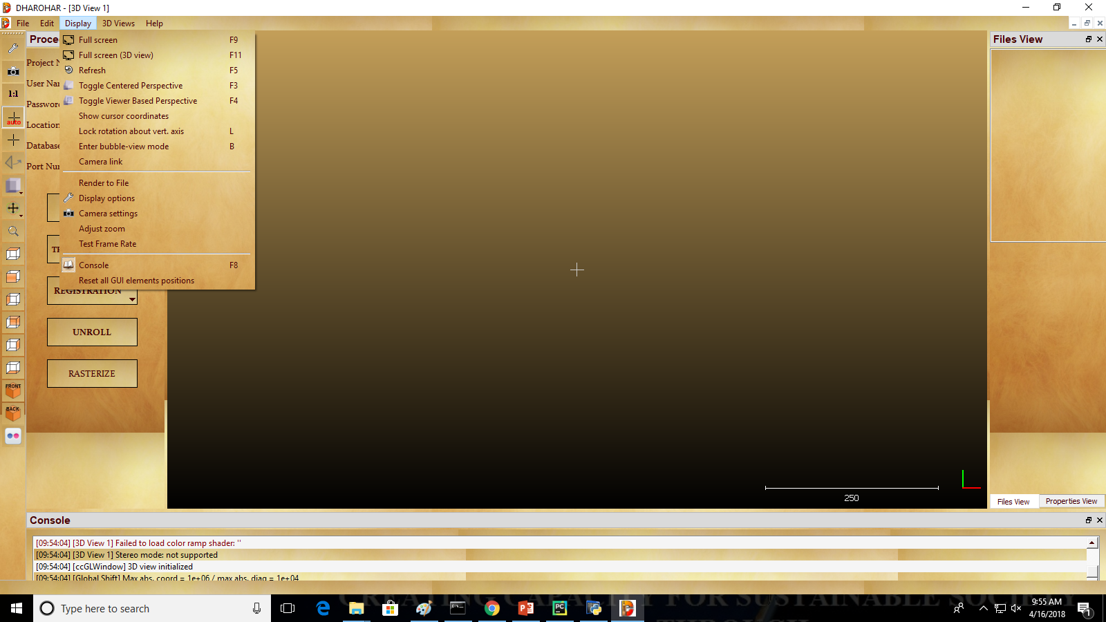
Display Menu

Slide 20
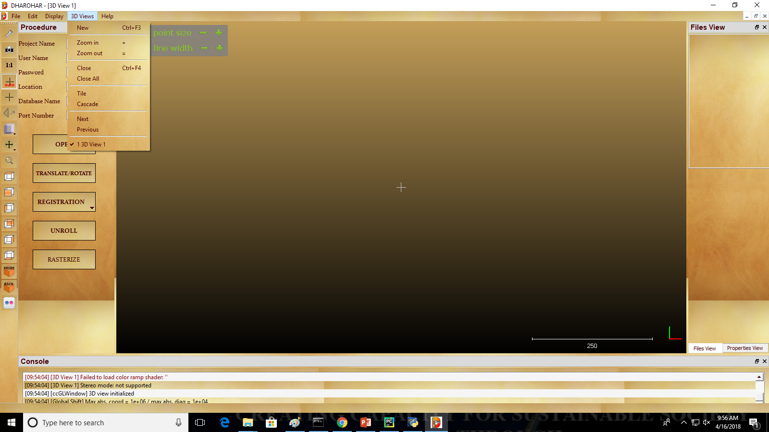
3D Views Menu

Slide 21
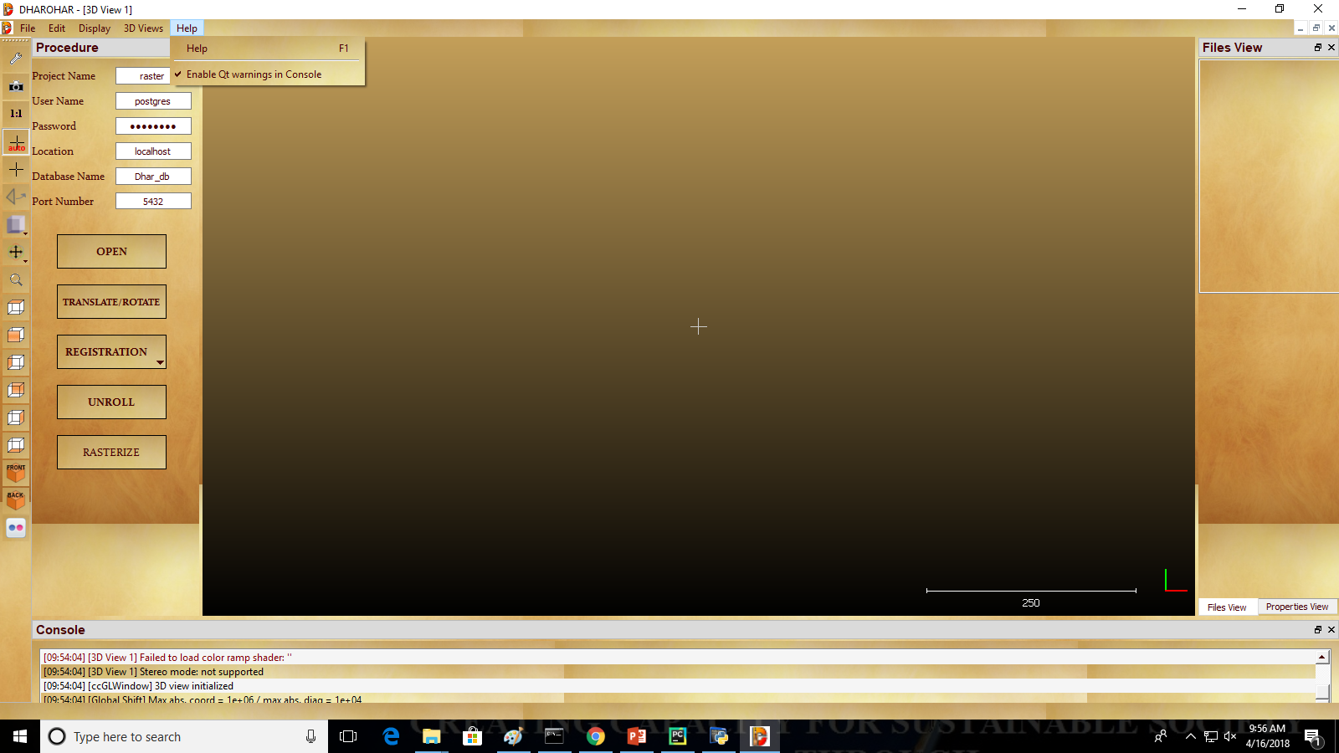
Help Menu

Slide 22
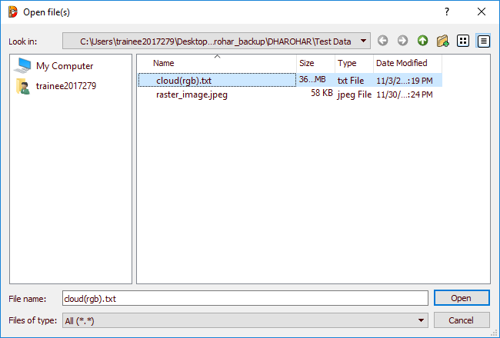
Visualize Point Cloud

Slide 23
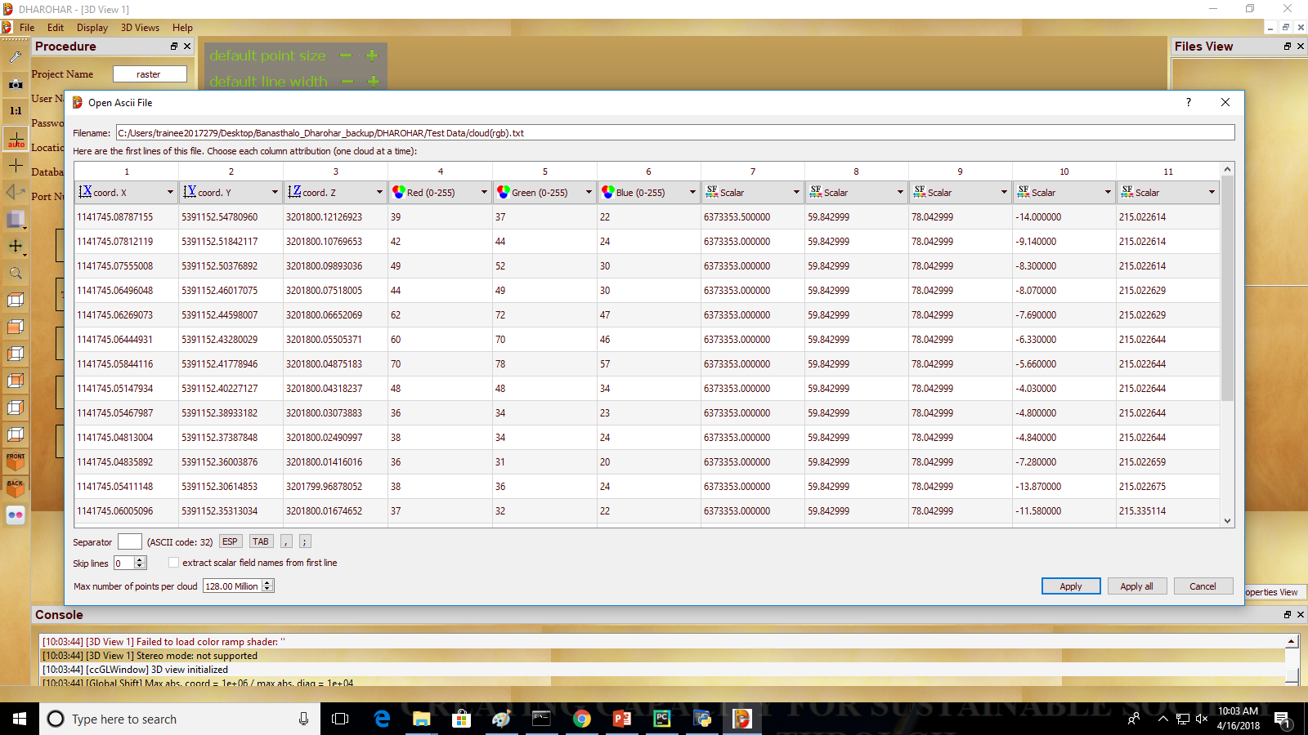

Slide 24
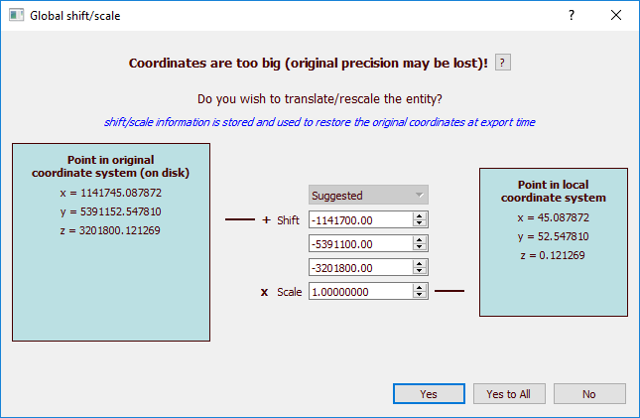

Slide 25
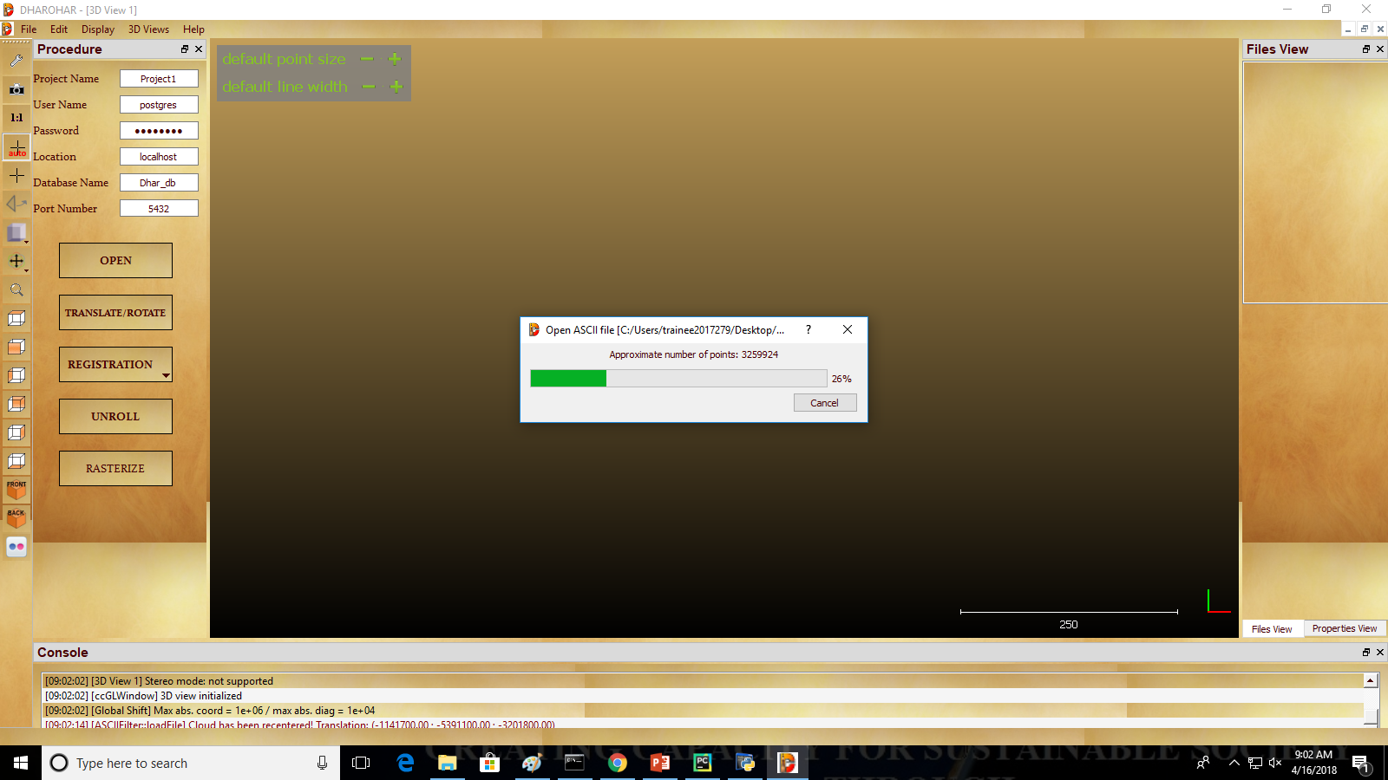

Slide 26
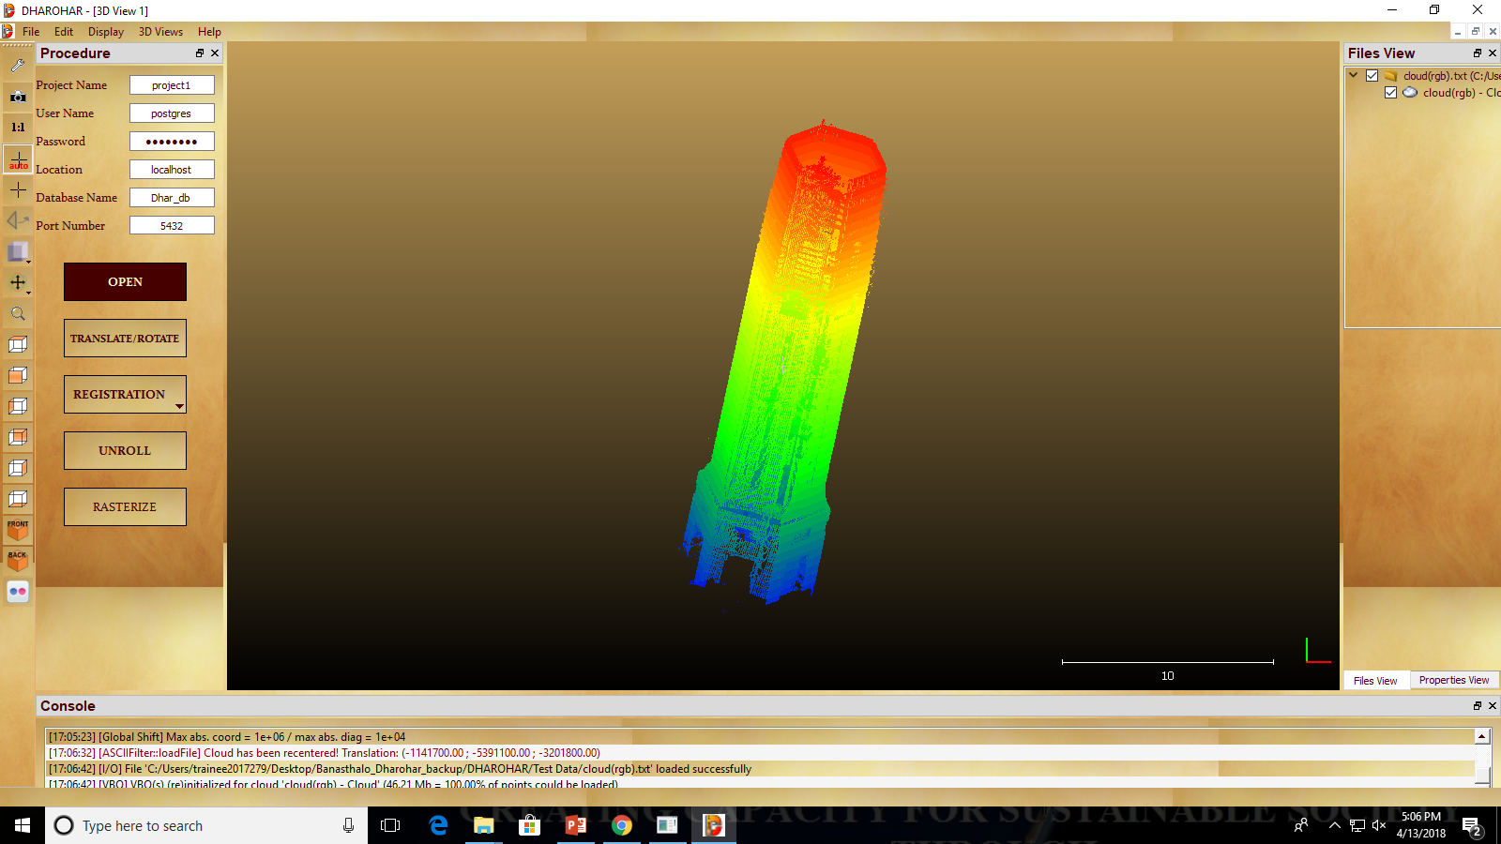
Opened point cloud

Slide 27
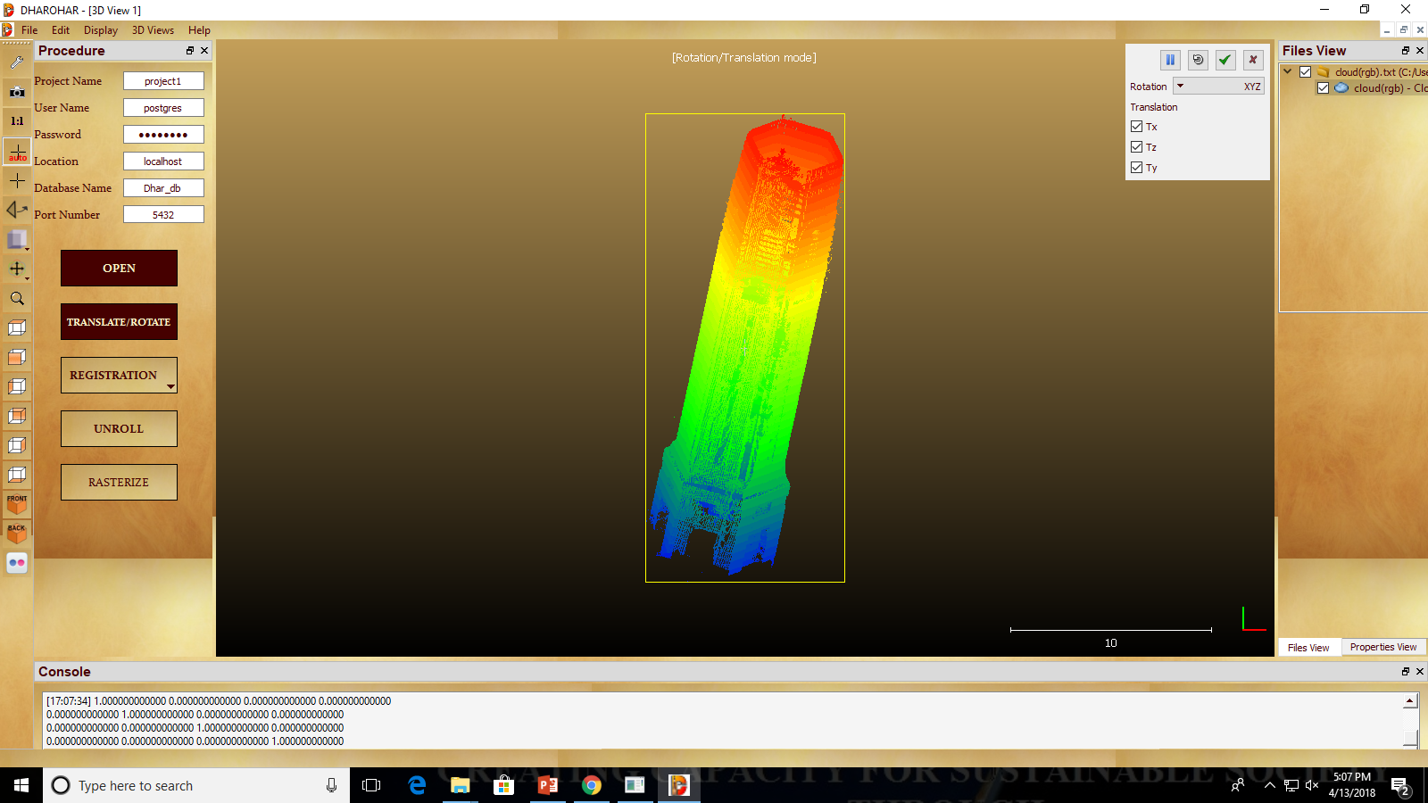
Translate Point Cloud

Slide 28
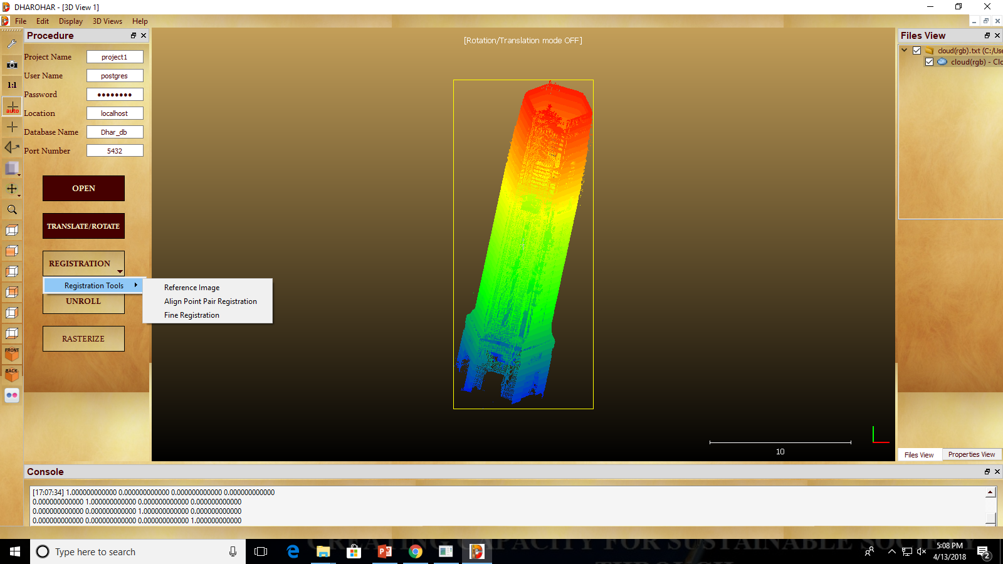
Registration

Slide 29
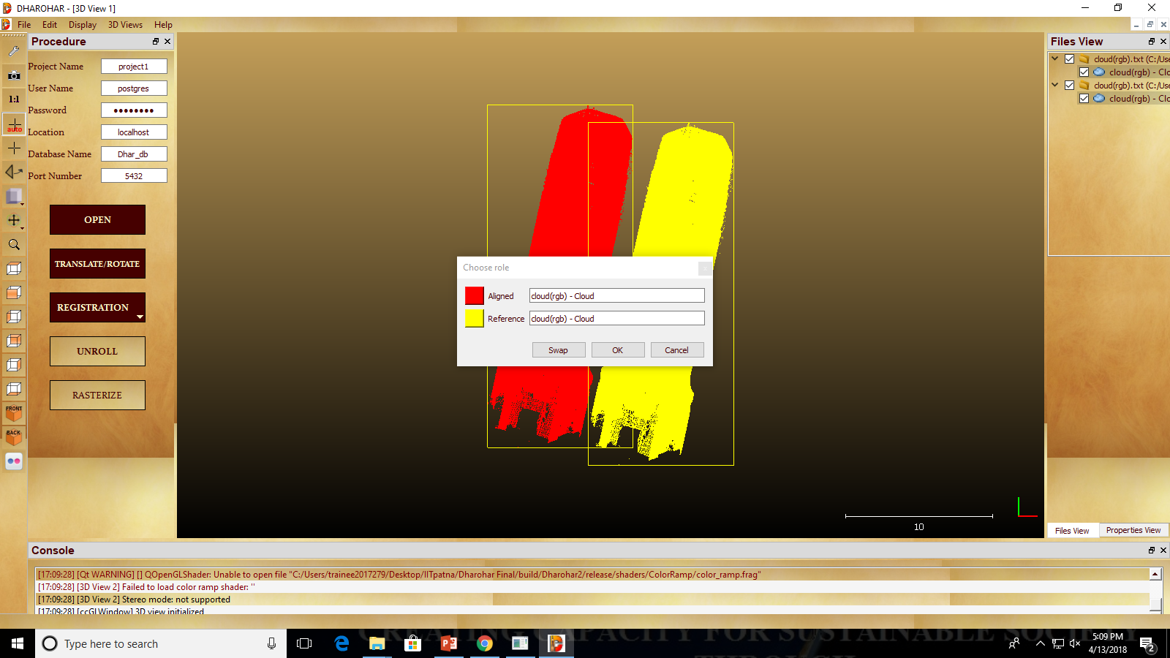
Align point pair

Slide 30
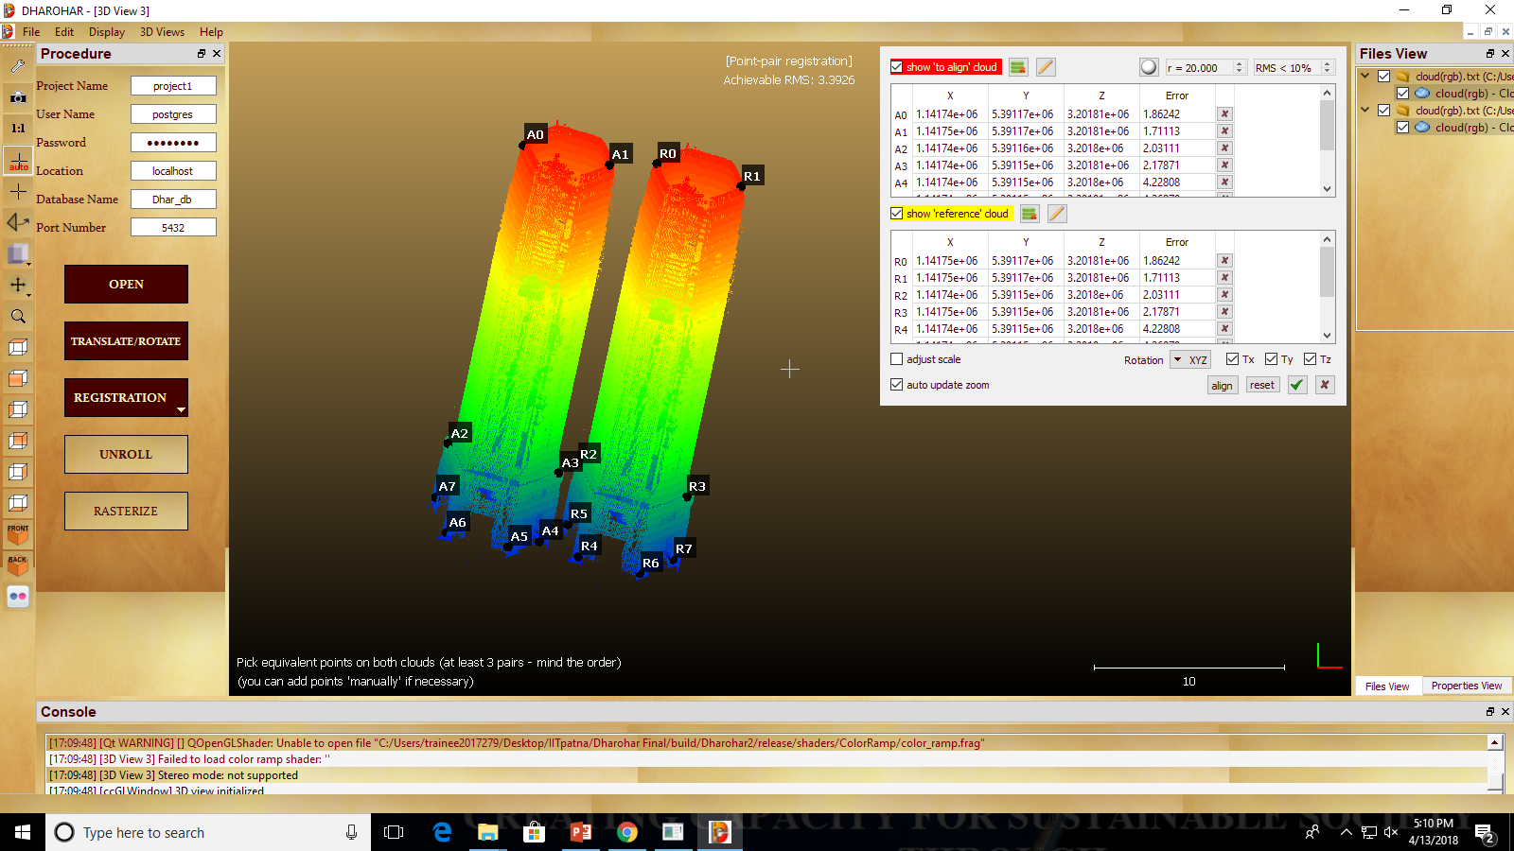
Picking points for registration

Slide 31
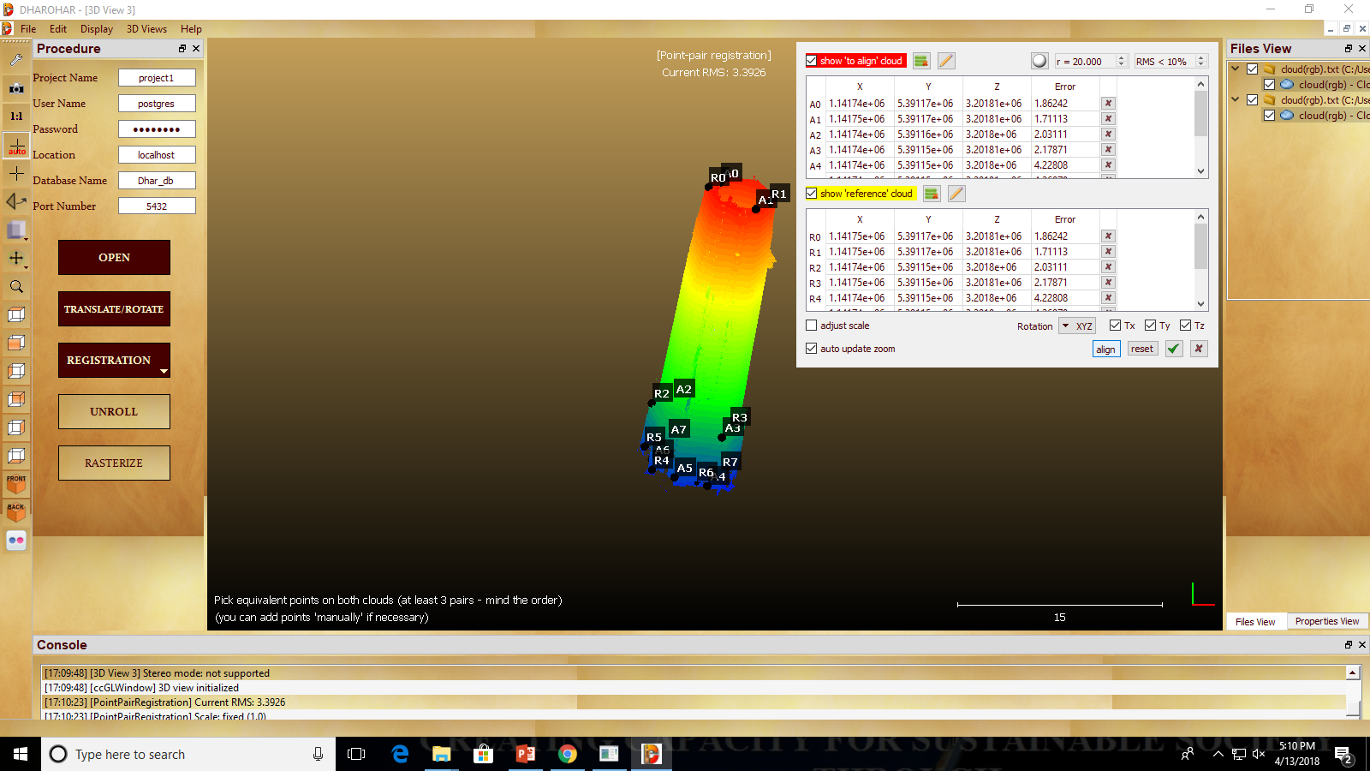
After Applying Align Point Pair Registration

Slide 32
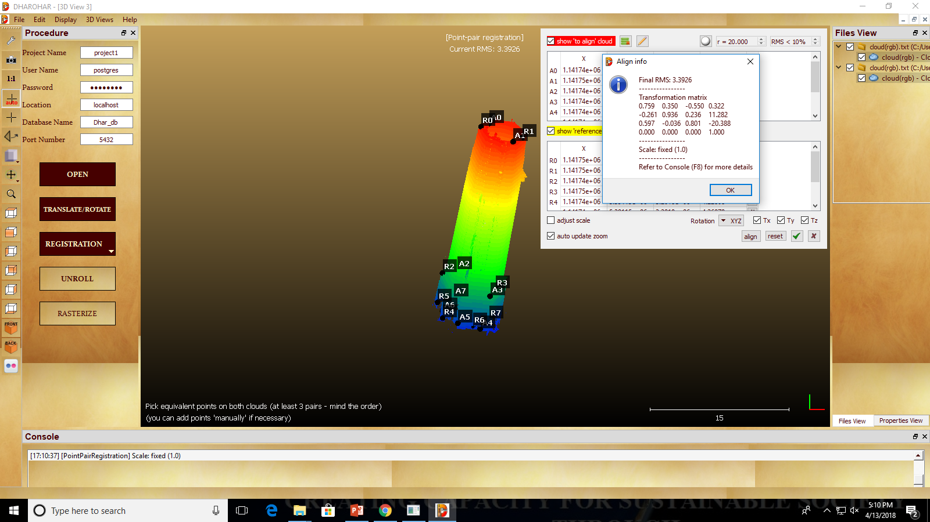
RMS output of Align Point Pair registration

Slide 33
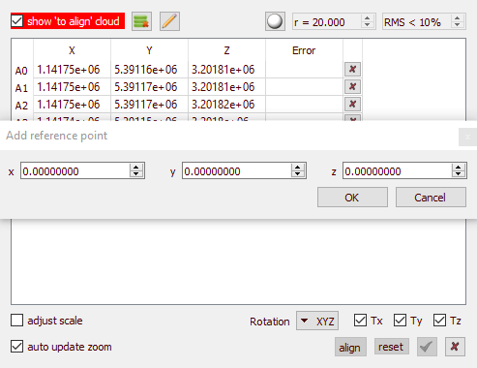
Adding Manual Points for Registration

Slide 34
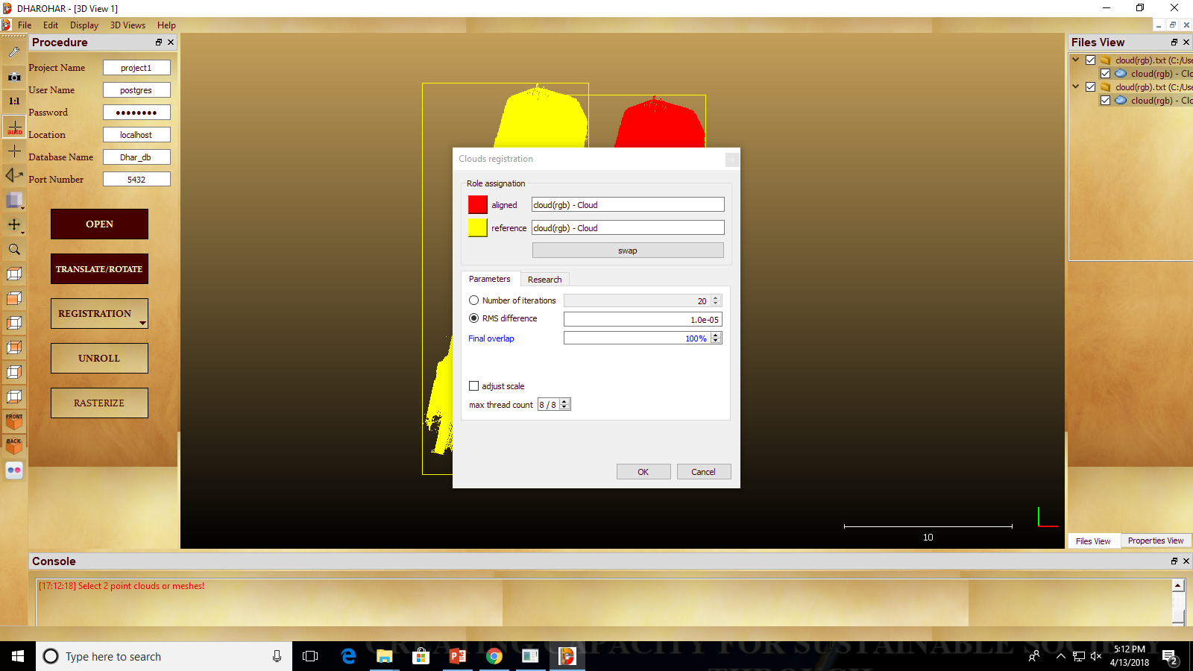
Fine Registration

Slide 35
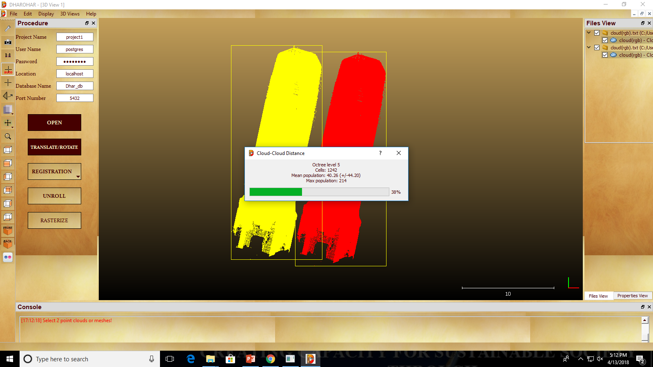
Applying Fine Registration

Slide 36
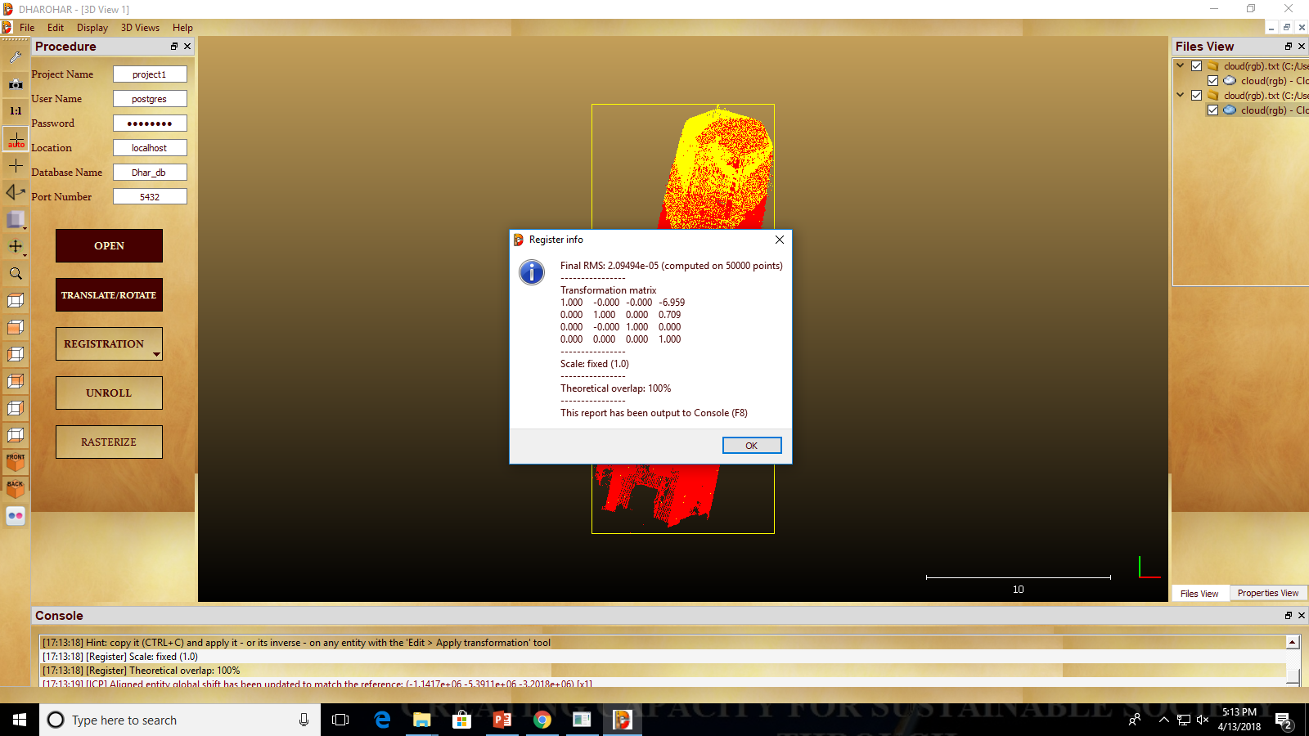
RMS output of Fine Registration

Slide 37
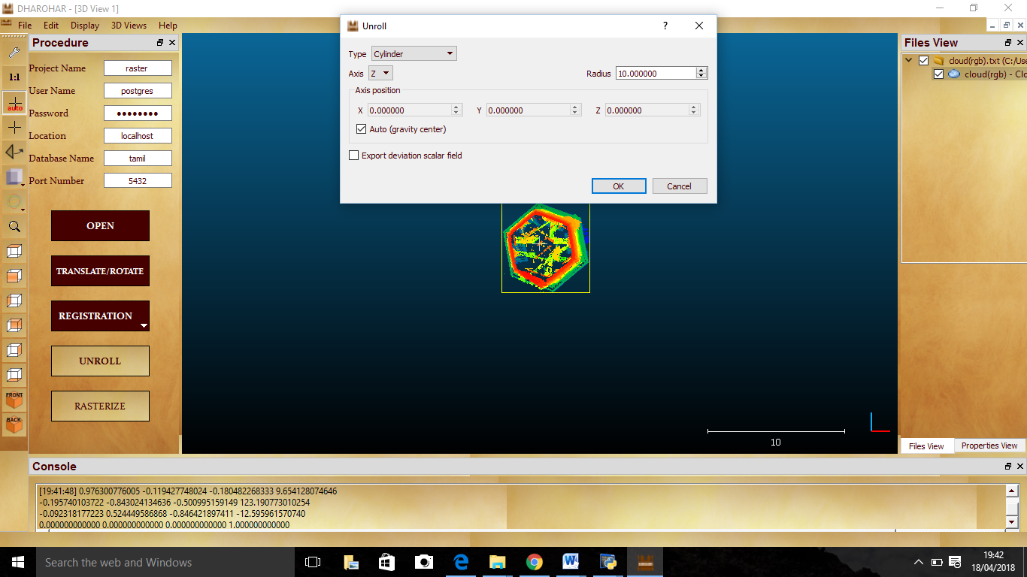
Unroll

Slide 38
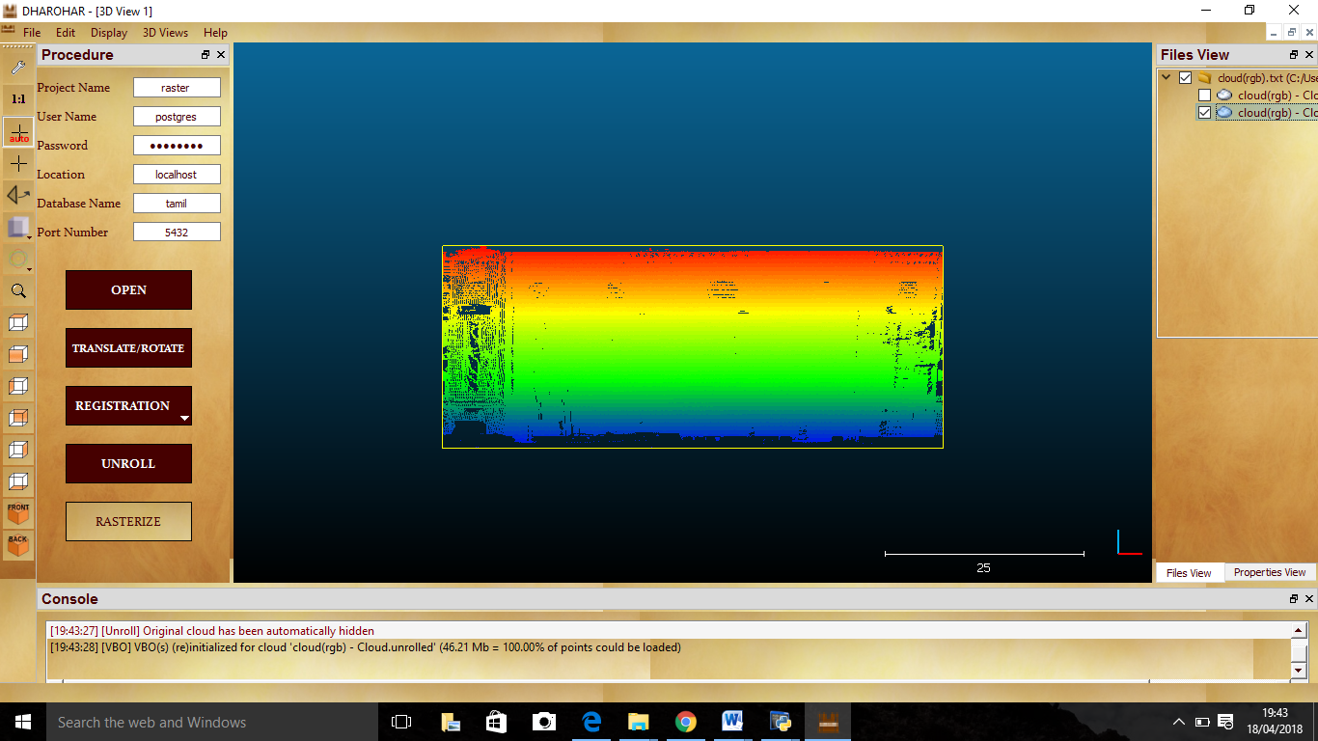
Unrolled Point Cloud Image

Slide 39
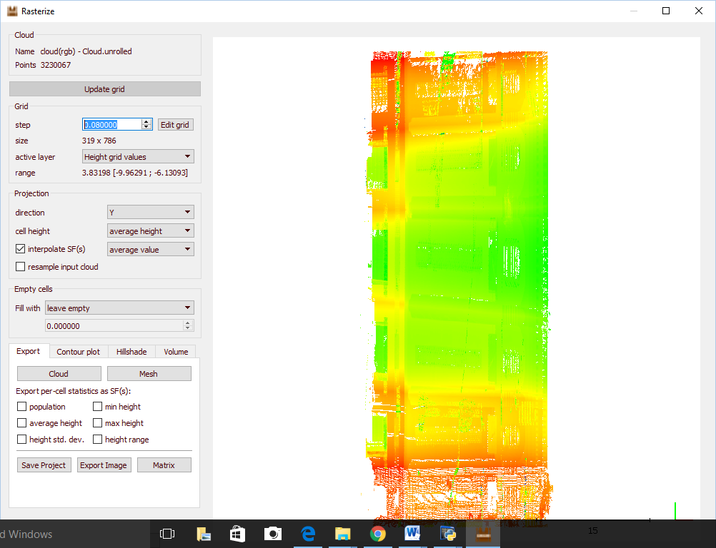
Rasterize Point Cloud

Slide 40
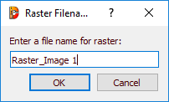
Save raster Image to Database

Slide 41
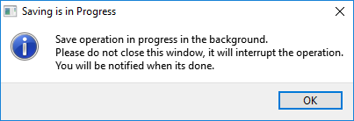
Saving in progress

Slide 42
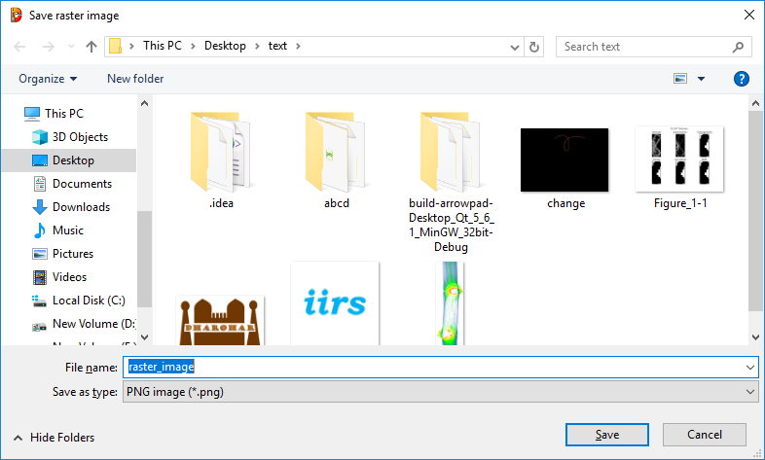
Export Raster image to File

Slide 43
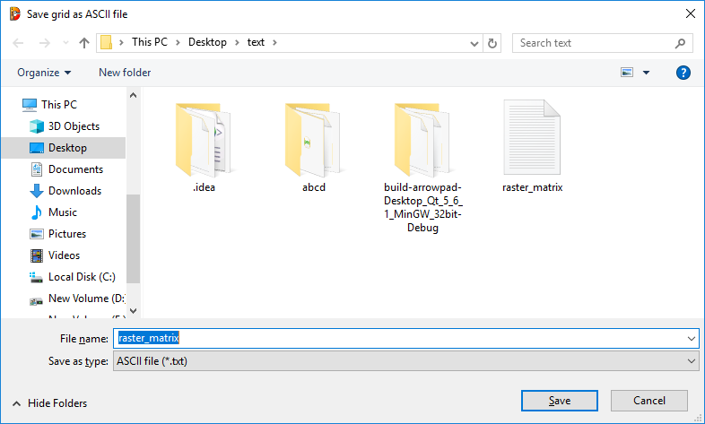
Save Raster Image as ASCII Matrix

Slide 44
IMAGE PROCESSING

Slide 45
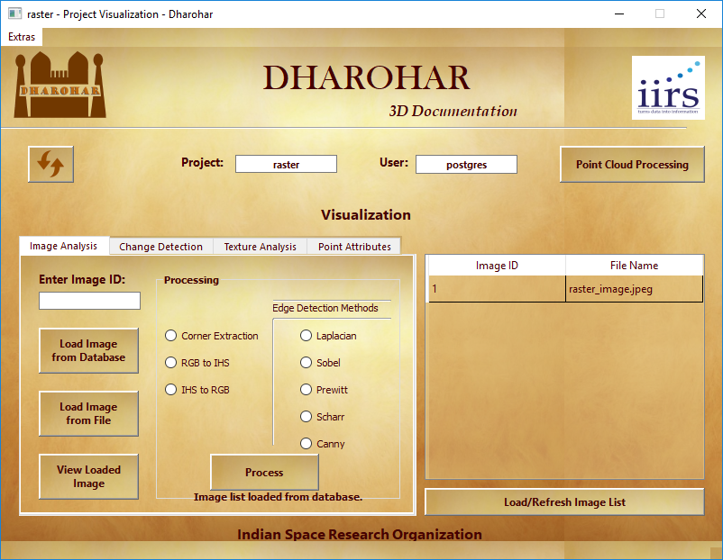
Image List In database

Slide 46

Loading image from database

Slide 47
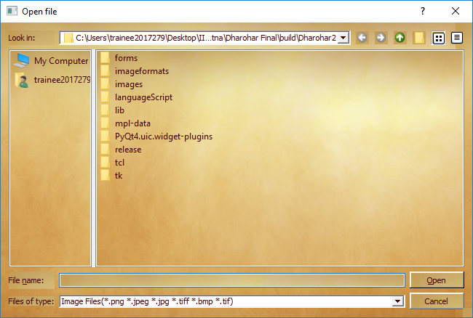
Loading image from file

Slide 48
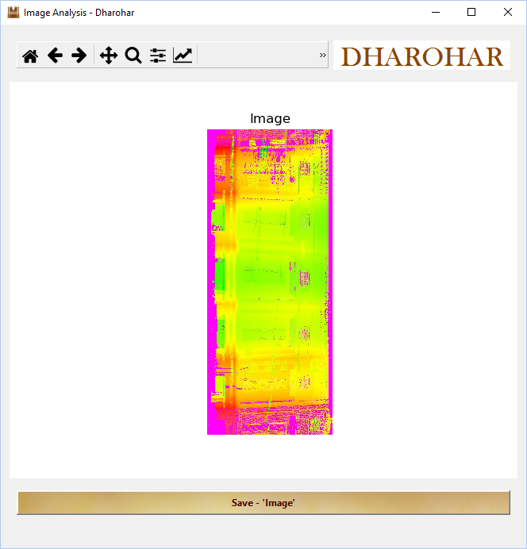
Viewing loaded image

Slide 49
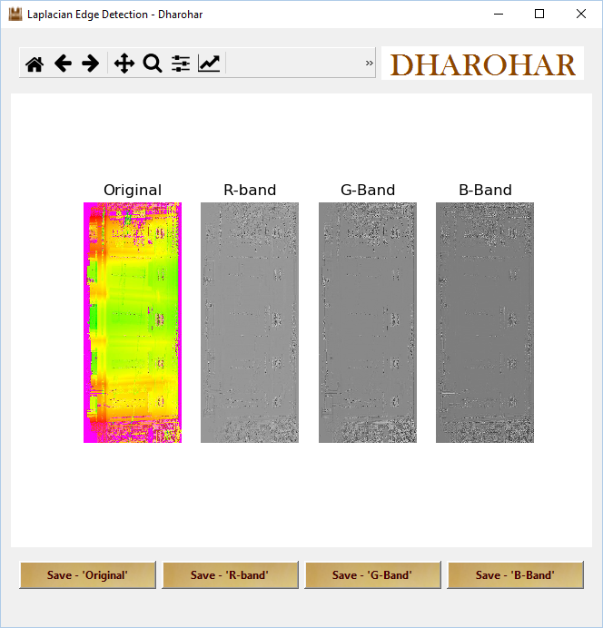
laplacian

Slide 50
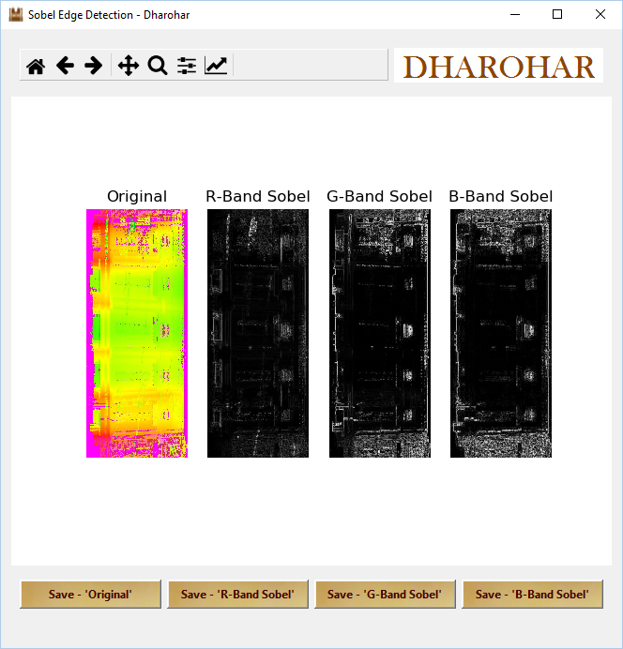
sobel

Slide 51

Perwitt

Slide 52

Scharr

Slide 53
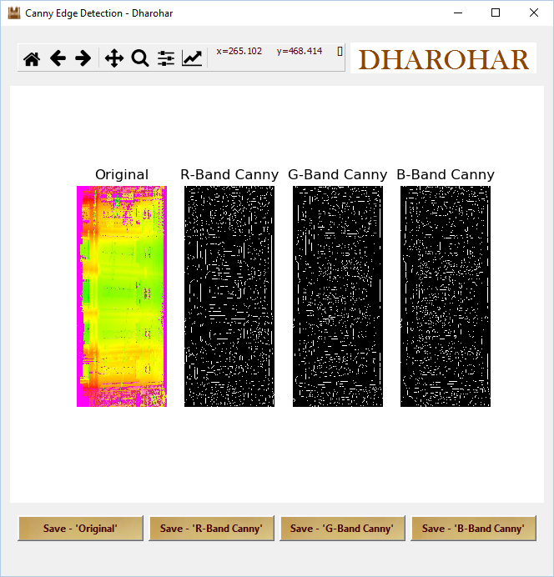
Canny

Slide 54
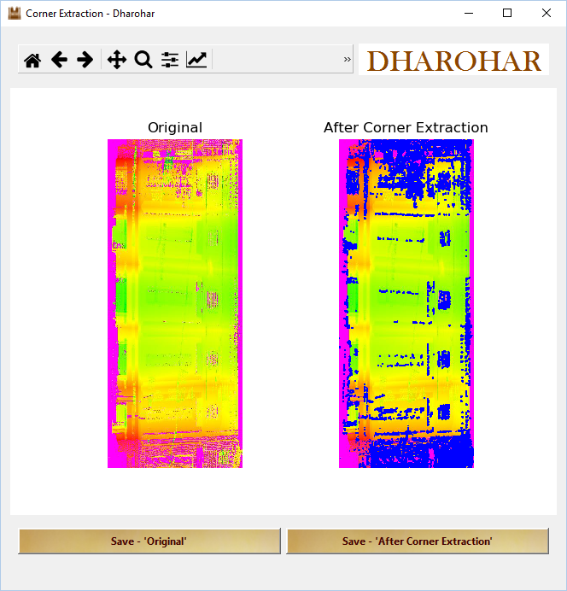
Corner Extraction

Slide 55
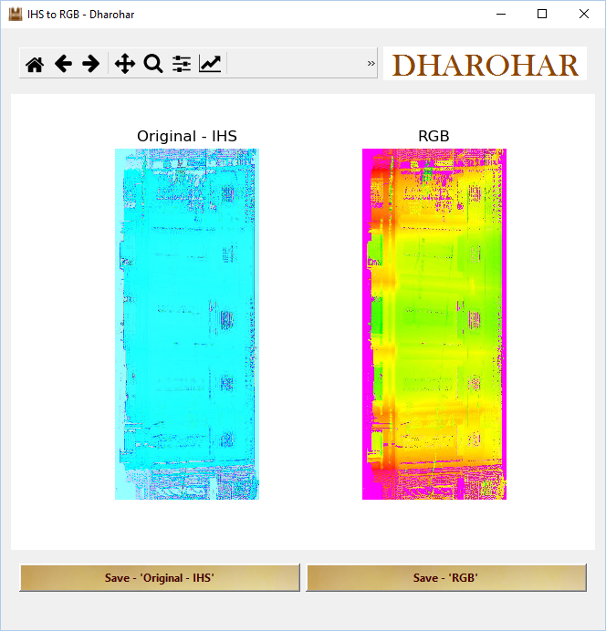
IHS to RGB

Slide 56
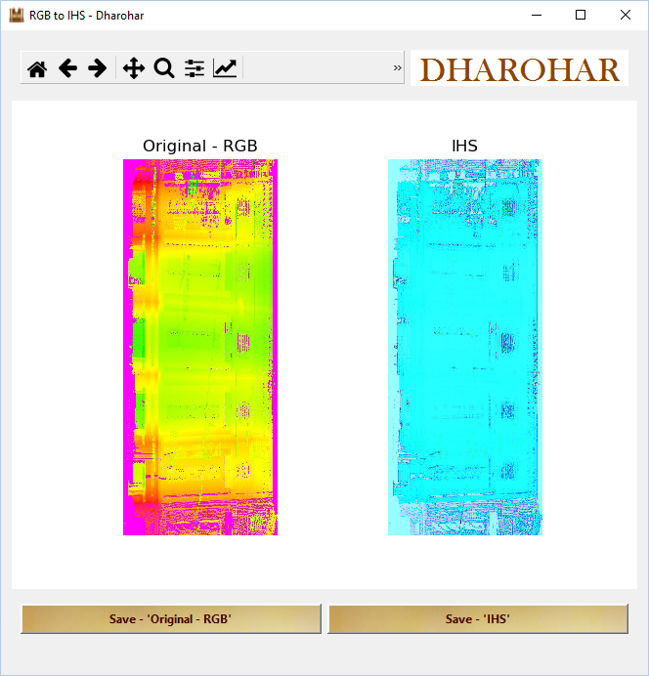
RGB to IHS

Slide 57
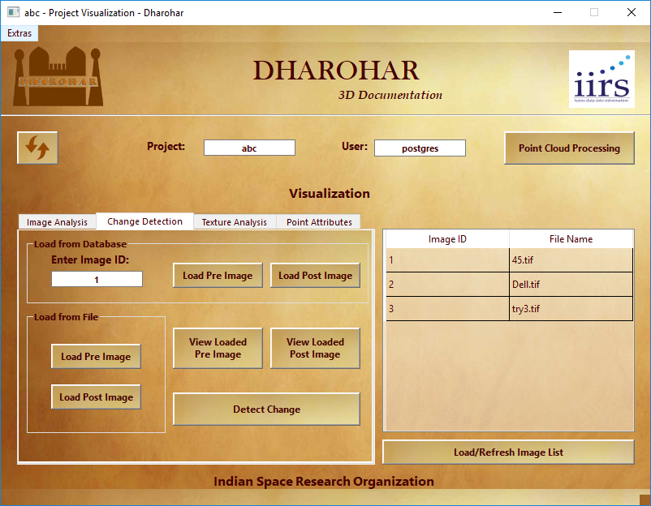
Change detection

Slide 58
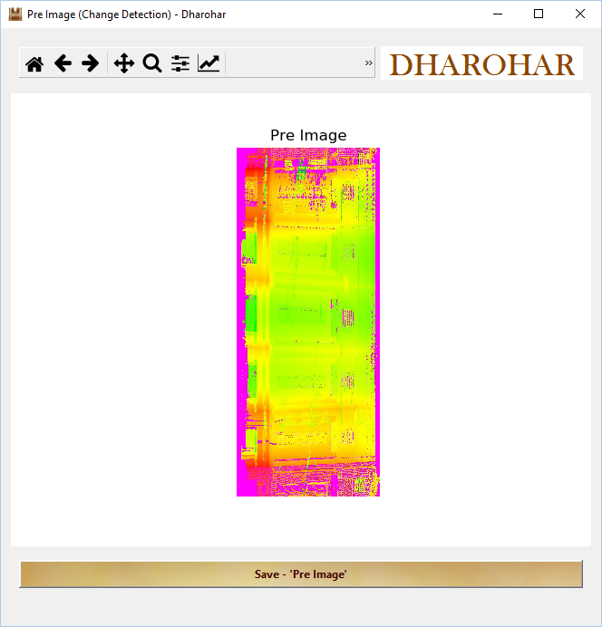
View Loaded Pre-Image

Slide 59

View Loaded Post-Image

Slide 60
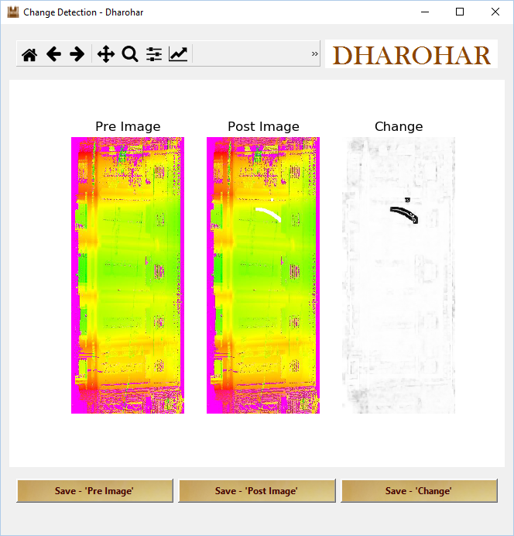
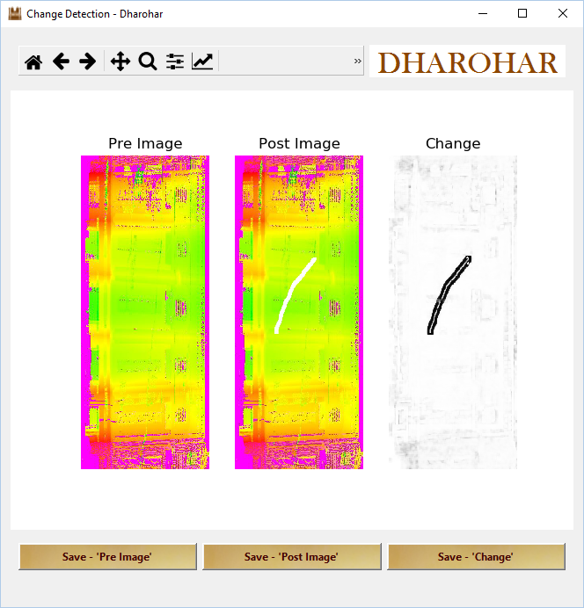
Detected Change

Slide 61

Texture Analysis

Slide 62

View Loaded Image

Slide 63

R-Band Image

Slide 64

R-Band Pixels

Slide 65

Red Band GLCM (Angle:0, Distance:1)

Slide 66

Statistical Texture Of Image (Red)

Slide 67

B-Band Image

Slide 68

B-Band Pixels

Slide 69

Blue Band GLCM (Angle:0, Distance:1)

Slide 70

Statistical Texture Of Image (Blue)

Slide 71

G-Band Image

Slide 72

G-Band Pixels

Slide 73

Green Band GLCM (Angle:0, Distance:1)

Slide 74

Statistical Texture Of Image (Green)

Slide 75

Pixels and Statistical Texture can be Exported as .csv file

Slide 76

Point Attributes

Slide 77

3D Point Attributes

Slide 78

Outcome of 3D Point Attributes

Slide 79

Radius, Depth, Theta

Slide 80

Outcome of Radius, Depth, Theta

Slide 81
DATABASE

Slide 82

Tables Used

Slide 83

Table containing Raster Image

Slide 84

Table containing radius, depth and theta values

Slide 85

Table containing x,y,z values

